Slide 1
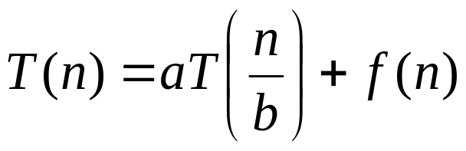
Master’s method
“Cookbook” for solving recurrences of the form:
where, a ≥ 1, b > 1, and f(n) > 0
Idea: compare f(n) with n^{log}_{b}ª
f(n) is asymptotically smaller or larger than n^{log}_{b}ª by a polynomial factor n^{ε}
f(n) is asymptotically equal with n^{log}_{b}ª

Slide 2
Master’s method
“Cookbook” for solving recurrences of the form:
where, a ≥ 1, b > 1, and f(n) > 0
Case 1: if f(n) = O(n^{log}_{b}^{a -ε}) for some ε > 0, then: T(n) = Θ(n^{log}_{b}ª)
Case 2: if f(n) = Θ(n^{log}_{b}ª), then: T(n) = Θ(n^{log}_{b}ª lgn)
Case 3: if f(n) = Ω(n^{log}_{b}^{a +ε}) for some ε > 0, and if
af(n/b) ≤ cf(n) for some c < 1 and all sufficiently large n, then:
T(n) = Θ(f(n))
regularity condition

Slide 3
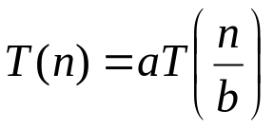
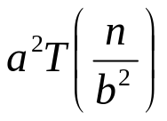
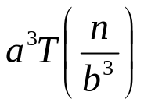
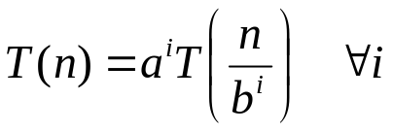
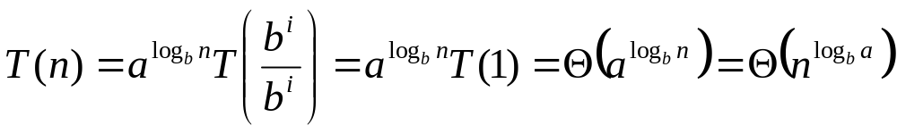
Why n^{log}_{b}ª?
Case 1:
  If f(n) is dominated by n^{log}_{b}ª:
    T(n) = Θ(n^{log}_{b}^{n})
Case 3:
  If f(n) dominates n^{log}_{b}ª:
    T(n) = Θ(f(n))
Case 2:
  If f(n) = Θ(n^{log}_{b}ª):
    T(n) = Θ(n^{log}_{b}ª logn)
Assume n = b^{k} ⇒ k = log_{b}n
At the end of iteration i = k:

Slide 4
Examples
T(n) = 2T(n/2) + n
a = 2, b = 2, log₂2 = 1
Compare n^{log}₂² with f(n) = n
⇒ f(n) = Θ(n) ⇒ Case 2
⇒ T(n) = Θ(nlgn)

Slide 5
Examples
T(n) = 2T(n/2) + n²
a = 2, b = 2, log₂2 = 1
Compare n with f(n) = n²
⇒ f(n) = Ω(n^{1+ε}) Case 3 ⇒ verify regularity cond.
a f(n/b) ≤ c f(n)
⇔ 2 n²/4 ≤ c n² ⇒ c = ½ is a solution (c<1)
⇒ T(n) = Θ(n²)

Slide 6

Examples (cont.)
T(n) = 2T(n/2) +
a = 2, b = 2, log₂2 = 1
Compare n with f(n) = n^{1/2}
⇒ f(n) = O(n^{1-ε}) Case 1
⇒ T(n) = Θ(n)

Slide 7
Homogeneous recurrences
Is of form a₀t_{n}+a₁t_{n-1}+…………a_{k}t_{n-k}.
Consider recurrence for fibonacci series
f_{n}=f_{n-1}+f_{n-2}
f_{n}-f_{n-1}+f_{n-2 =} 0
0

